Slide 1
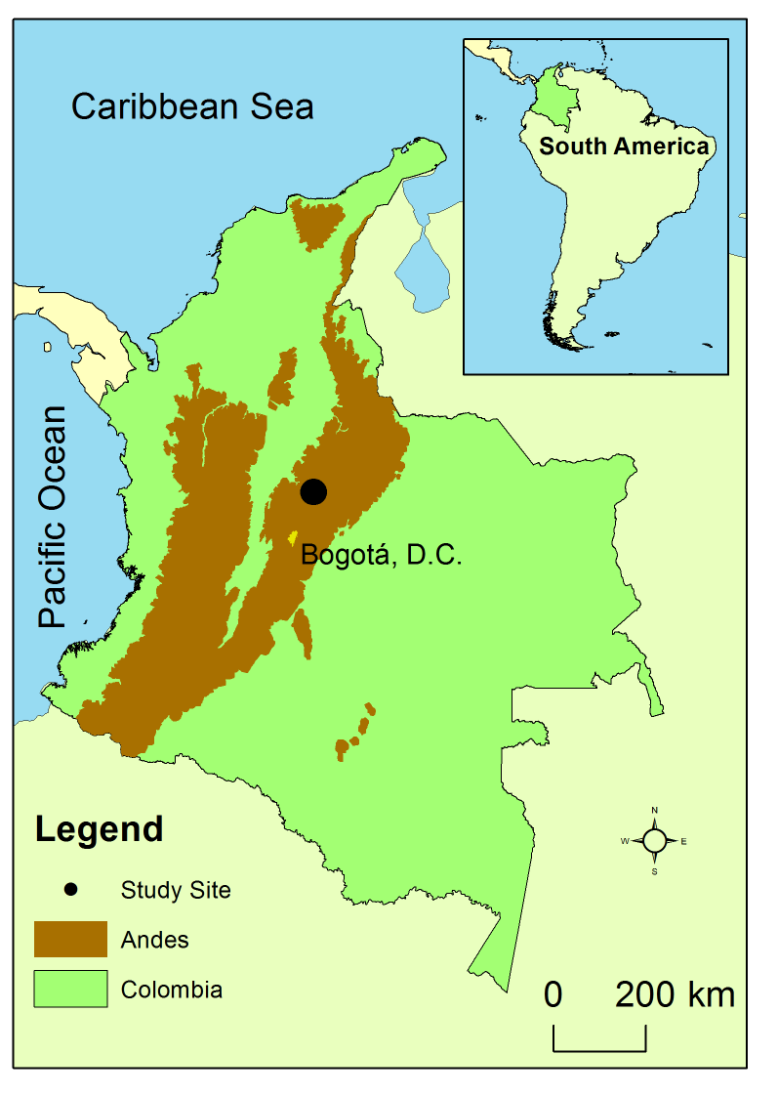
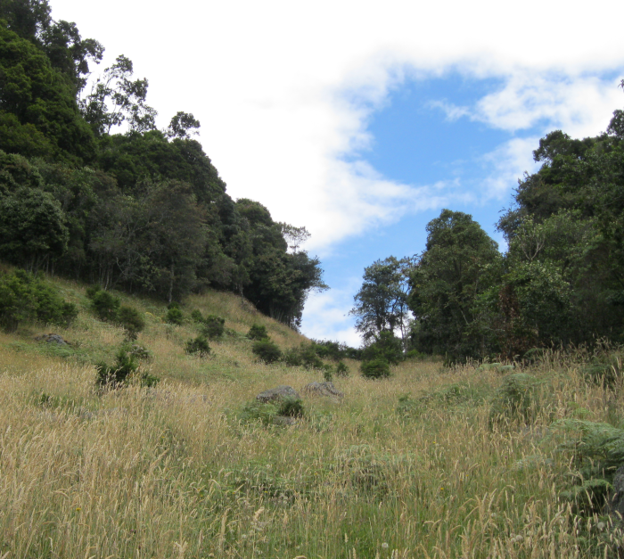
Study site
Colombia Eastern Andes
Andean high agro ecosystems
range altitude 2500-2900 m
Pasture, Oak forest Quercus humboldtii
Precipitation 1105.7 mm
Temperature 13°C
Relative humidity 85%

Slide 2
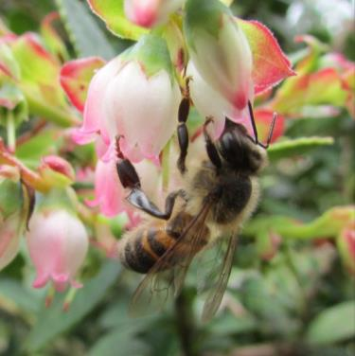
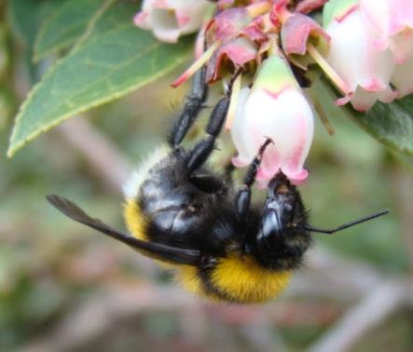
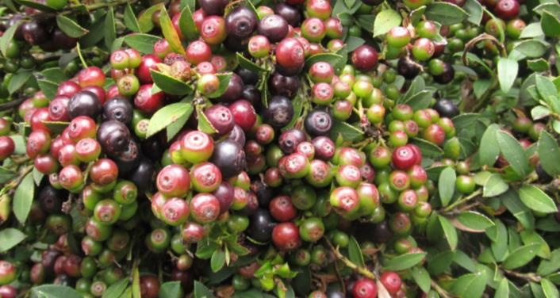
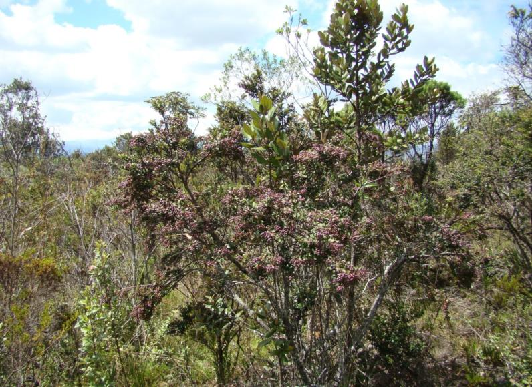
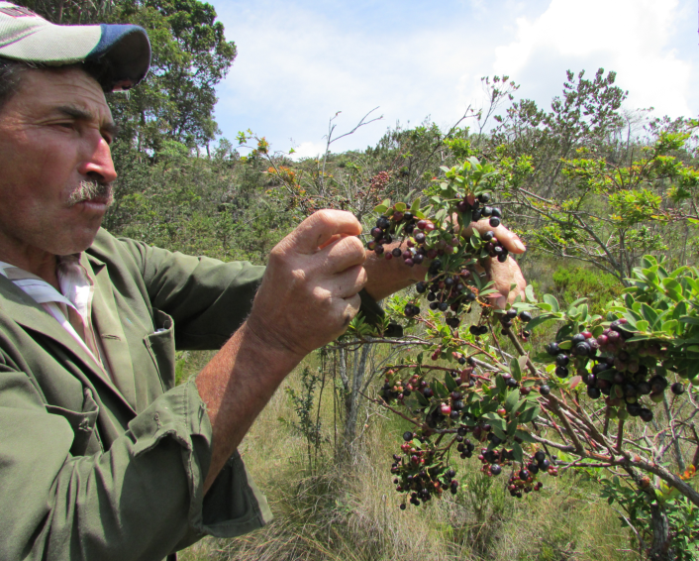
Crop
Vaccinium meridionale (Ericaceae)
Common name: Agraz or Mortiño
The plants grow naturally; they are generally not sown by the farmers.
Extremely asynchronic crop in terms of flowering. On the same plants "new" flowers and rape fruits.
The only management practice consist in removing native "weeds" in some farms.
Small farms

Slide 3
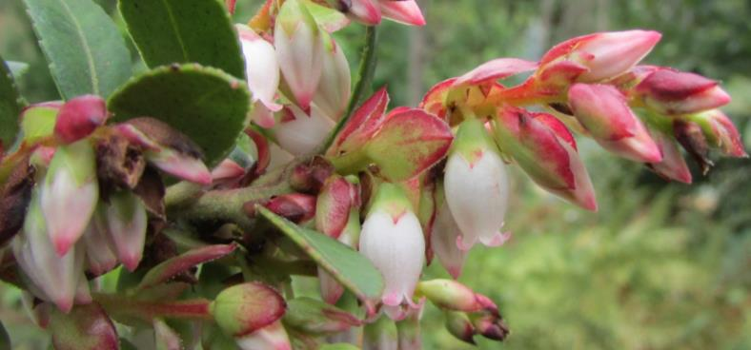
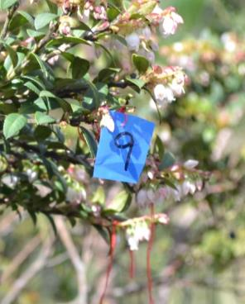
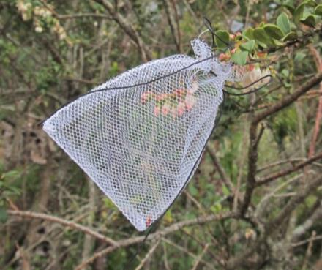
Sampling
Treatments: High vs. Low density of honey bees (Apis mellifera).
Replication: 6-10 sites honey bees, 6-10 sites without honey bees, 12-20 sites in total.
Characterization and selection of sites: soil, diversity of plants and the cover of these plants within the sampling plot.
Pollinator density: scan sampling, 50 racimes per plant, 8 plants per site,.
Pollinator diversity: sweep net captures, 6 plants per site.
Flower density and phenology*: 50 racimes per plant, 8 plants per site.
The three aspects above are going to be measured 4 times for each of 12-20 fields, therefore, 48-80 measurments in total: one morning, two mid-days, one afternoon. Each field will be visited once per two weeks.
Crop yield quantity and quality*: 8 plants per site, 4 plants with exclosures, 50 exclosures.
*the sampling will be performed by tagging the flowers and fruits to be observed.
Floral unit
Racime (10-20 flowers)

Slide 4
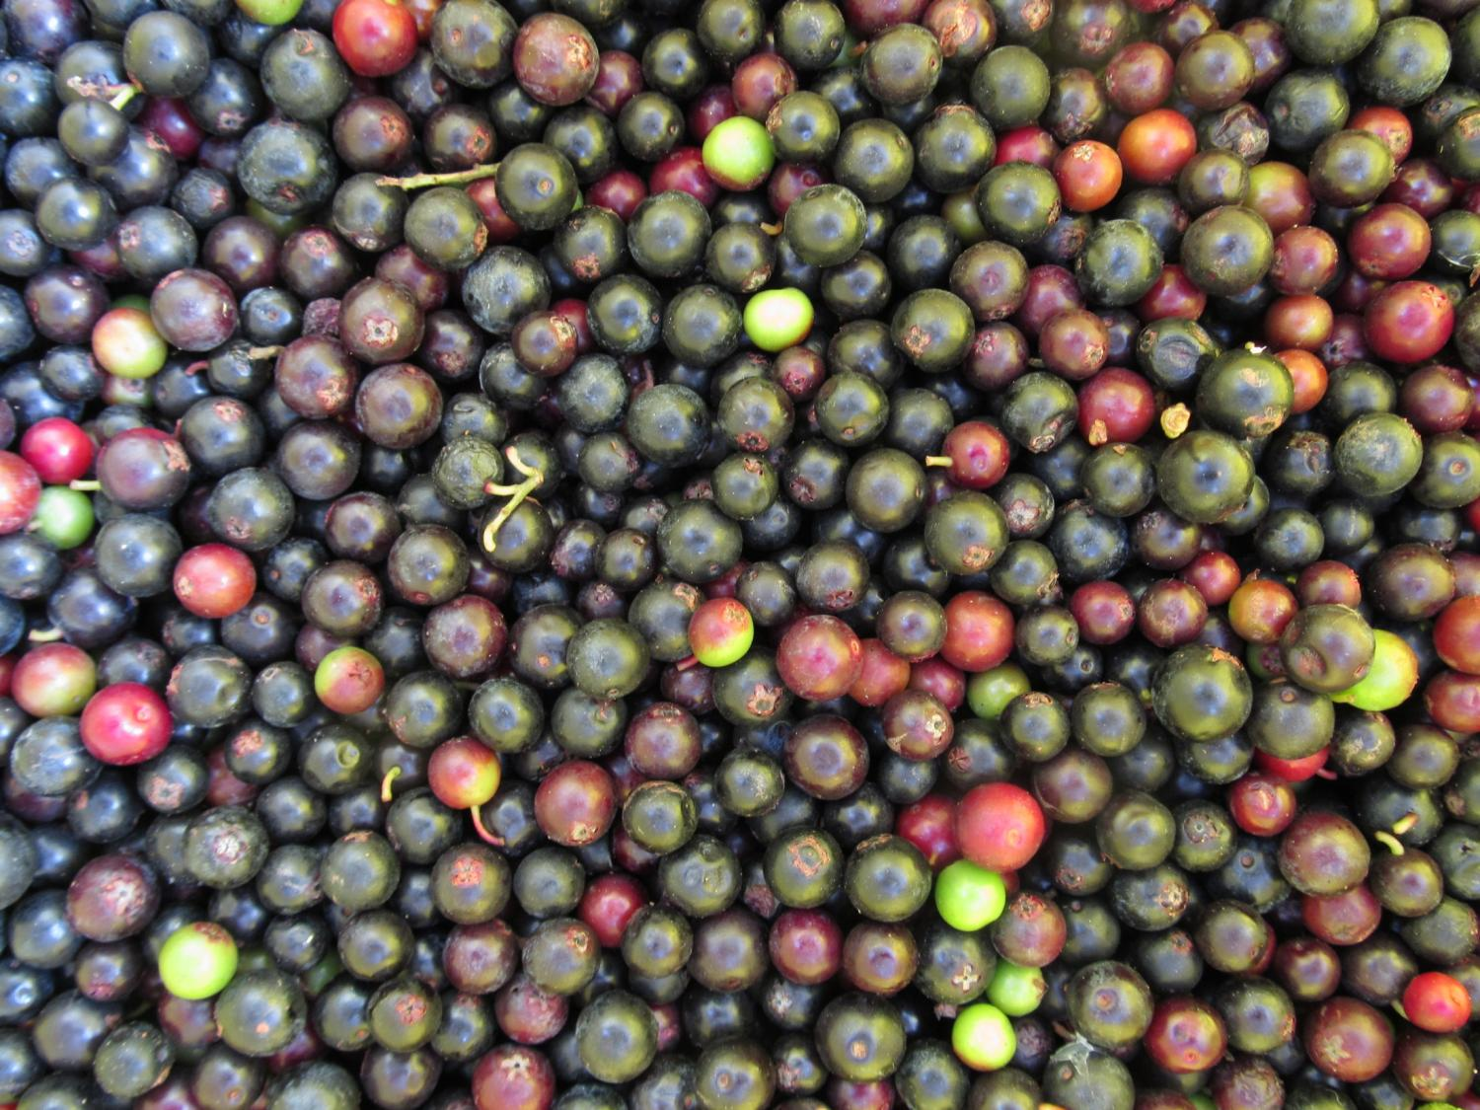
Comments
20 sites visited
12 characterized (landscape, soil and sampling plot plant diversity)
10 selected
10 eliminated (did not have the required distance between sites or low crop plants density.
Treatment | Replication | Range altitude | # Hives | Hives distance | Crop plant density
High | 5 | 2500-2900 | 2-5 | 2-500 m | 80-180
Low | 5 | 2600-2800 | 0-1 | >1500 m | 70-300
Variables to measure | J-13 | A-13 | S-13 | O-13 | N-13 | D-13 | J-14 | F-14 | M-14 | A-14
Pollinator density | X | X | X | X
Pollinator diversity | X | X | X | X
Flower density and phenology | X | X | X | X
Crop yield quantity and quality |  |  |  |  |  |  | X | X | X | X

